Slide 1
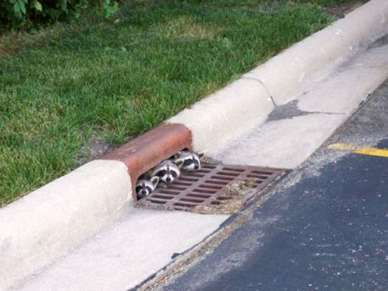
PI Day 3
Welcome BACK!
Notes:
Zoe up front: 9-9:15
Take sharing about assignment of attracting something- (have them stand, give their name and share.)
Take several stories then ask them to turn to someone ner them and share more.
Briefly explain the rest of the day, and how we’ll be busy to the very end.
9:15-9:45
Explanation of Ultimate Truth Statement and demo, done in segments
Pass to Linz…

Slide 2
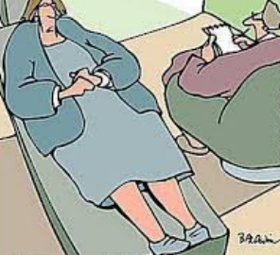
Anatomy of a session
I had trouble expressing
my anger… even before
Botox!

Slide 3
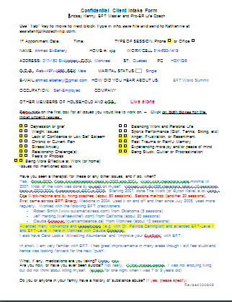
Before a session
send client an Intake Form
and appointment confirmation
review form ahead of time
note discussion topics or questions
have their form, your notes, water, pen, and writing tablet
have a telephone for recording

Slide 4
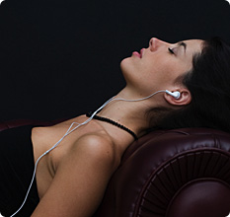
Greeting clients
pay your clients a sincere compliment
chat about a current event, weather, traffic
offer them water, tea, restroom, margarita
help them relax with humor

Slide 5

Beginning a session
SMILE (even on the phone!)
find a common theme for discussion
share something about yourself
explain about recording the session
be confident, enthusiastic and
reassuring

Slide 6
let’s practice!

Slide 7
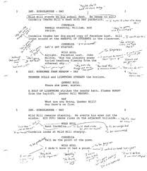


Session write up

Slide 8
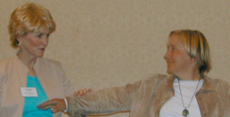
During the (first) session
ask about their most pressing issue first
ask their overall objectives
introduce the energy system via muscle testing
before you start tapping,
explain reversals
take notes like crazy

Slide 9

During the session tips
be OK not knowing where you are going
let your Intuition guide you
tap along with them
reframe when appropriate
endeavor to neutralize
every issue

Slide 10

More session tips
check their intensity every 2-3 rounds
ask for any M. E. T.’s that
come up
invite him / her to participate using ping-ponging
use Revenge Tapping (by Kiya Immergluck) for really anger peeps
Red Alert

Slide 11

Still more
Test each issue, when at a zero, to make sure the client is clear… not just ‘much better’
“How do you know you’re
at a zero?”
“Duh! My wife told me I was!”

Slide 12
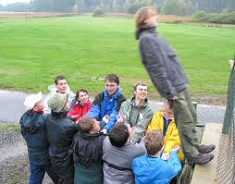
At the end of a session
allow at least 5 minutes to “taper off” the session
make sure the client feels safe at the end
provide him / her with a sense of closure
instill positive statements about him/her
give clients meaningful
homework*
* see PI webinar 2

Slide 13

After the session
make notes to yourself about how you ended and anything remarkable ….
write down what you want to do with them the next time.
send them the recording and anything else you promised.
the next day (or that evening) call
or email to see how client is doing

Slide 14
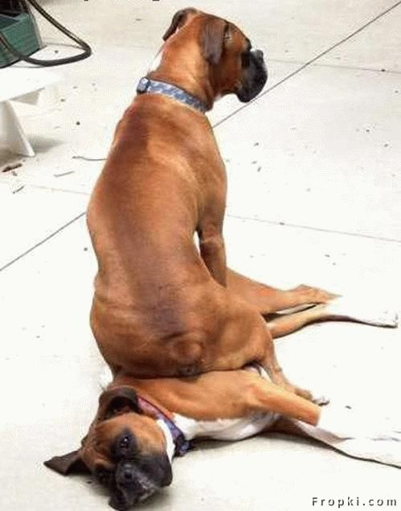
lunch
please eat with others
please be back by 1:45

Slide 15

Ultimate Choice
or universal reversal

Slide 16
Ultimate Choice Process
WHEN to use it
when life seems bleak or not worthwhile
when not committed to this being here
when seriously or chronically ill
when a family member(s) or friends have died
(usually more than one loss)
do not use this method for
someone who is suicidal

Slide 17
when listless, depressed or feeling hopeless
after experiencing a series of traumatic events or
horrific failures or losses
when you say “What’s the point? I really
don’t want to do this anymore”
when you just want to go to sleep and not
wake up. “I just don’t care!”
do not use this method for someone
who is suicidal

Slide 18
Ultimate Choice
set up
tap on KC while saying; “Even though I don’t want to live, I want to accept myself… ET I don’t want to live, I don’t really want to die either…
I just want to run away. I just don’t want to live like this and a part of me wants to die. way. And I want to accept these different parts of me.”

Slide 19
ultimate choice
sequence
start tapping on the points:
I don’t want to live… and just saying that
sucks (stinks, hurts, etc.)
I don’t want to die and I don’t want to live
I feel helpless and stuck and wish I could just disappear

Slide 20
Ultimate Choice
sequence
since I don’t want to live, and I don’t want to die, I need to opt into a different choice, a different life. I want to live differently.
continue on the points alternating; I don’t want to live… with but I don’t want to die (add in “yes I do…NO I don’t)

Slide 21
Ultimate Choice
sequence
repeat for 1-2 rounds
transition to: Since I don’t want to live, and I don’t want to die, I need to make a different choice, a different life. I want to live differently.”

Slide 22
ultimate choice
more sequences
continue with: I do want to live…no I don’t…YES, I do! I could never kill myself and do that to my family. I want to live. So I choose IN, and choose to live differently.
continue on the points, alternating “I don’t want to live” with “but I don’t want to die. And since I’m already alive, I might as well choose to live.

Slide 23
ultimate choice
install positive statements
I acknowledge myself for doing this work and for tapping back into my life. I now choose to live!
since I’m choosing to live, then I choose to
commit to my life.
since I’m committing to live, I choose to
commit to living at 100%

Slide 24
Ultimate Choice
wrap-up
I choose to do whatever it takes to live a good life. I owe that to myself. And I deserve it.
I’m smart. I have personal resources, I choose to turn this around. Instead of being a victim, I want to be my own biggest fan.

Slide 25

ultimate choice
wrap-up
go back to original issue and complete it
again, do not use this method for
someone who indicates
they are suicidal

Slide 26
demo

Slide 27
Logistics

Slide 28
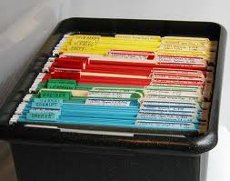
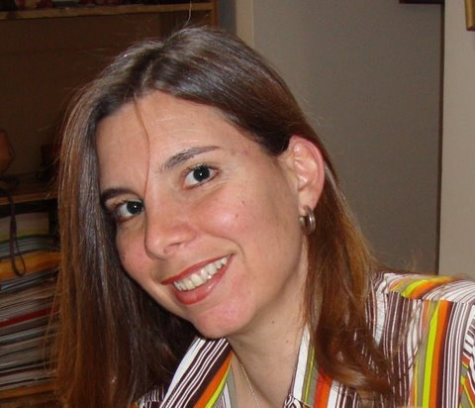
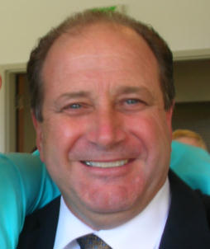
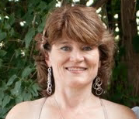
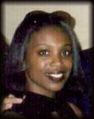

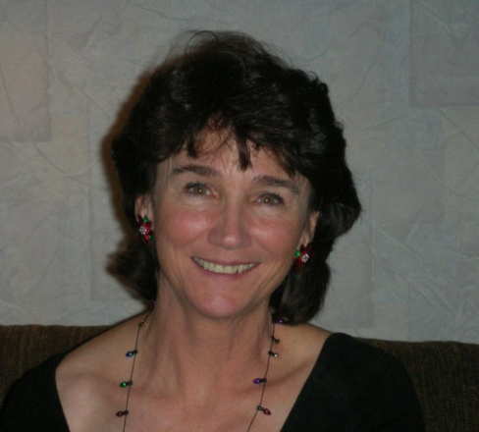

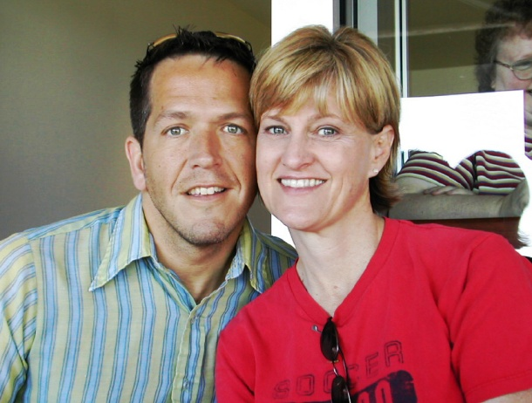
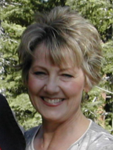
Joe Bigel
client folders

Slide 29






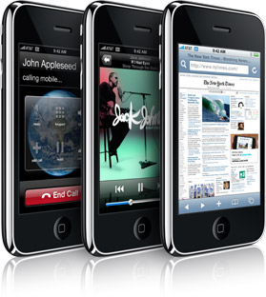
payments
keeping track of appointments
day timer
computer
mobile devices

Slide 30
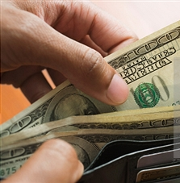
how much should I charge?
$65 / hr.
$85
$100
$150
$200
$1000

Slide 31

Lindsay’s tips to provide better service to clients…
… and increase your income by

Slide 32
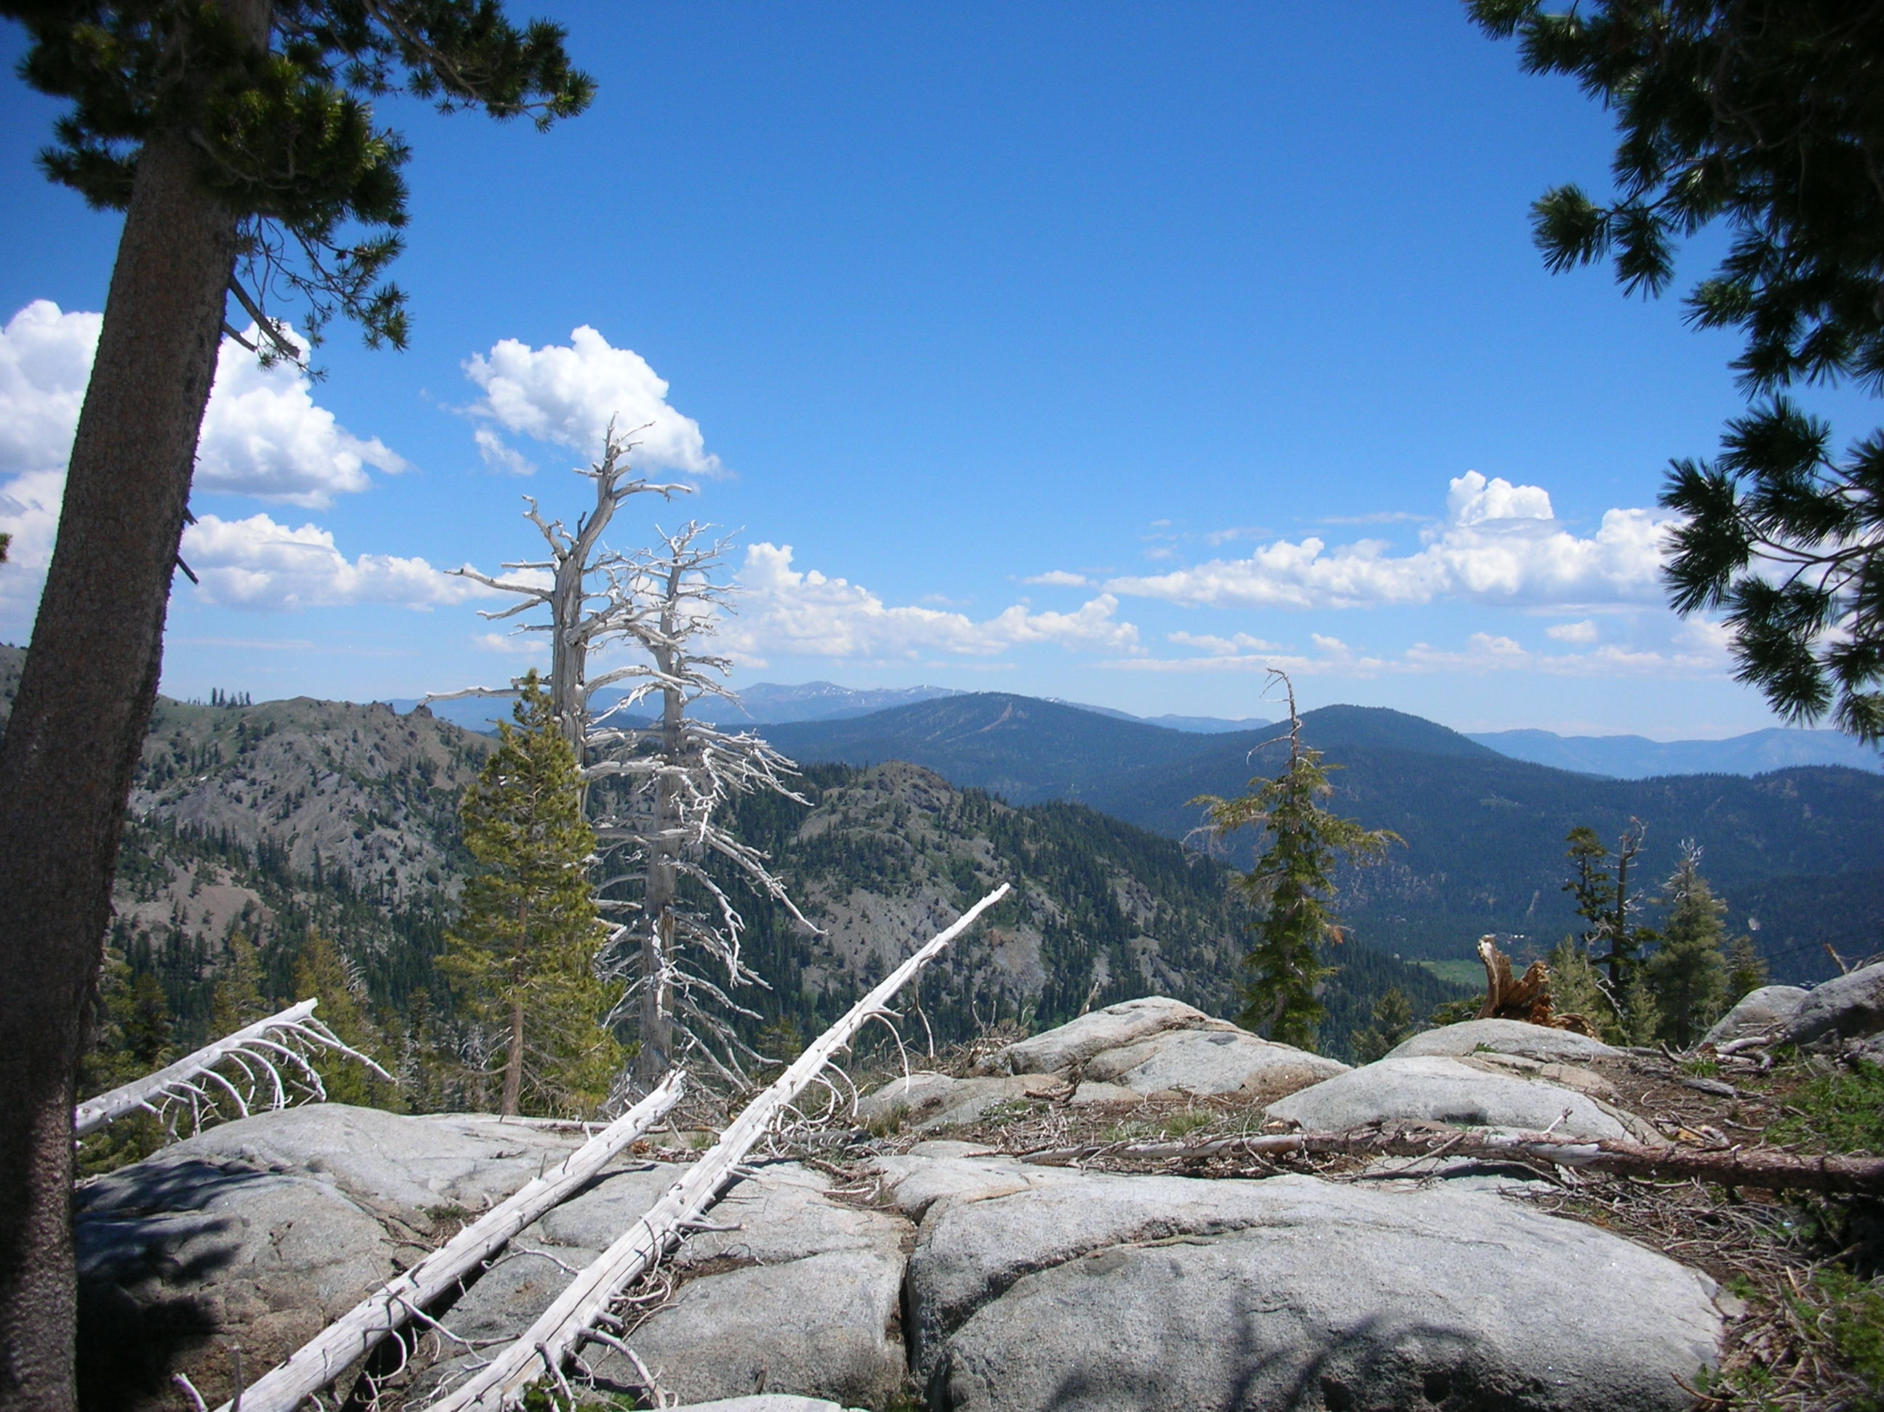
Q and A about sample test

Slide 33
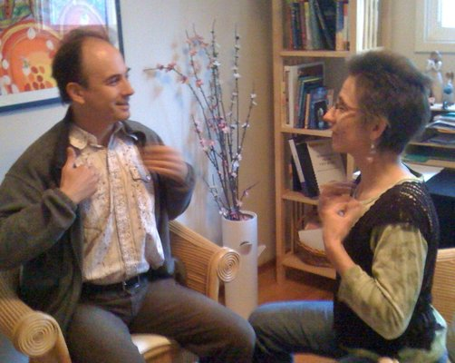
homework
tap with classmate on role reversals.
practice doing a “session”
practice the ultimate
choice process
study your notes from
today & for test tomorrow
be in your seats at 9

